Slide 1
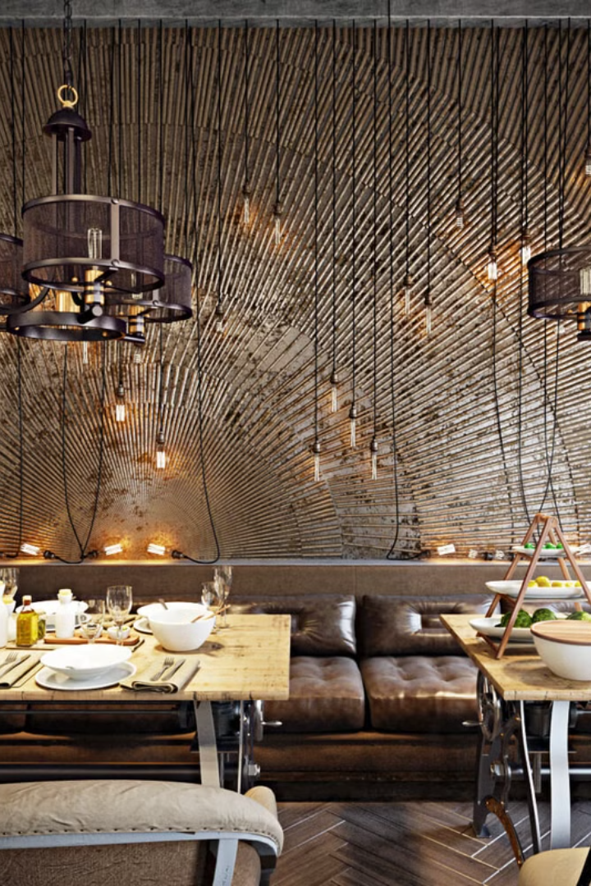
Food Ordering System: A C++ Application
A C++ application designed to optimize food ordering, offering separate modules for admins and customers.

Slide 2


Streamlining the Ordering Process
Efficient Management
User-Friendly Interface
Easily manage food items, process orders, and oversee system operations.
Seamlessly browse menus, place orders, and track them in real-time.

Slide 3

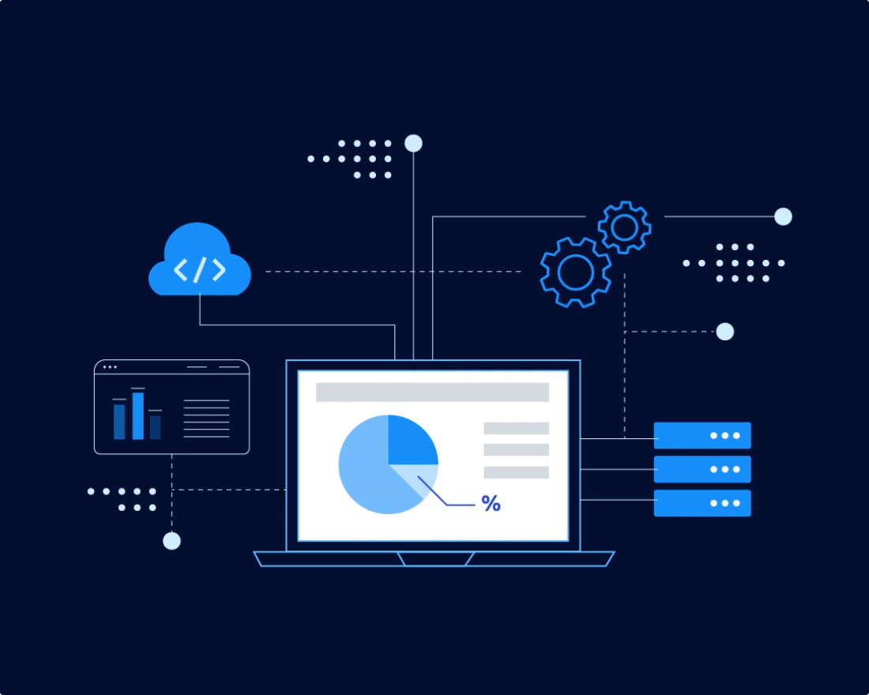
Technical Foundation
1
C++ Development
2
Structured Interface
The system is built using C++, ensuring performance and scalability.
A well-designed admin panel and customer interface for intuitive use.
3
Security Focus
Robust security measures protect user authentication and transaction processing.

Slide 4

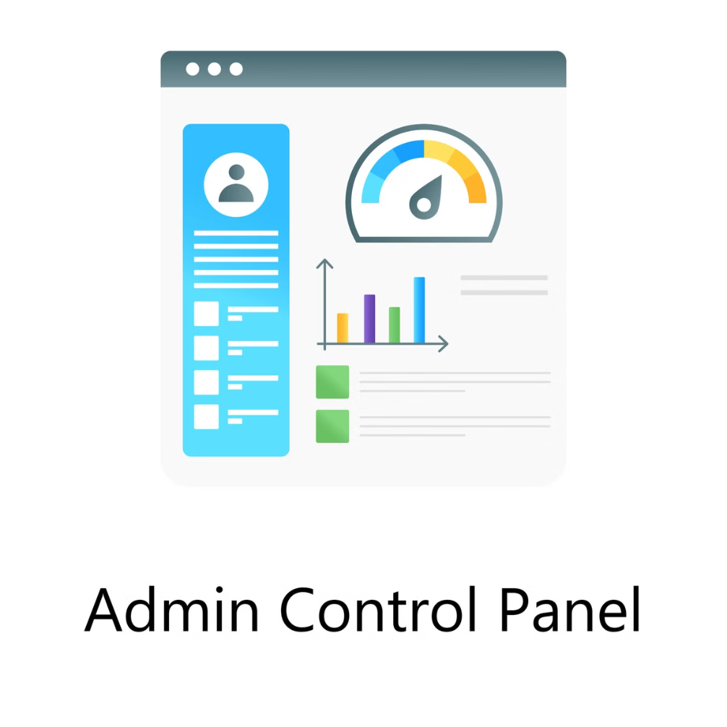
Admin Control
Secure Login
Manage Food Items
Admins have access to a secure login area with restricted access.
Admins can add, edit, and delete food items to keep the menu up-to-date.
Process Orders
Admins can view and process customer orders efficiently.

Slide 5
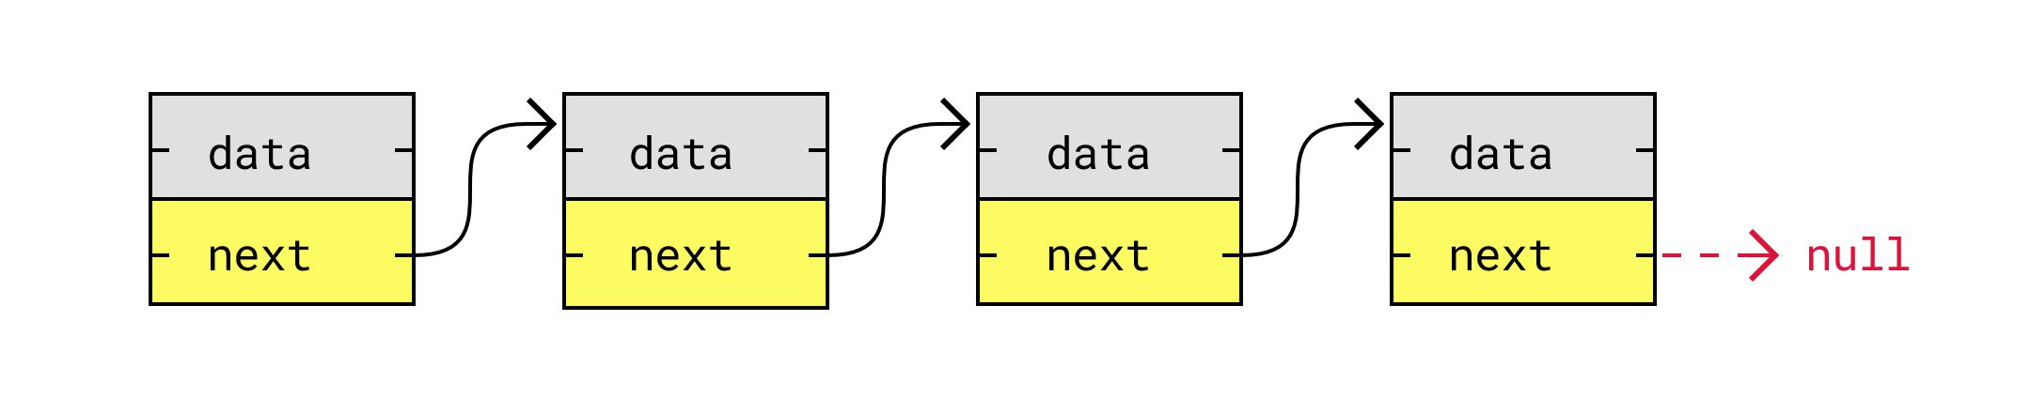
Data Storing Using Linked List
Stores order details dynamically as customers place orders.
Maintaining menu items efficiently.
Enabling quick modification of order
in memory.

Slide 6
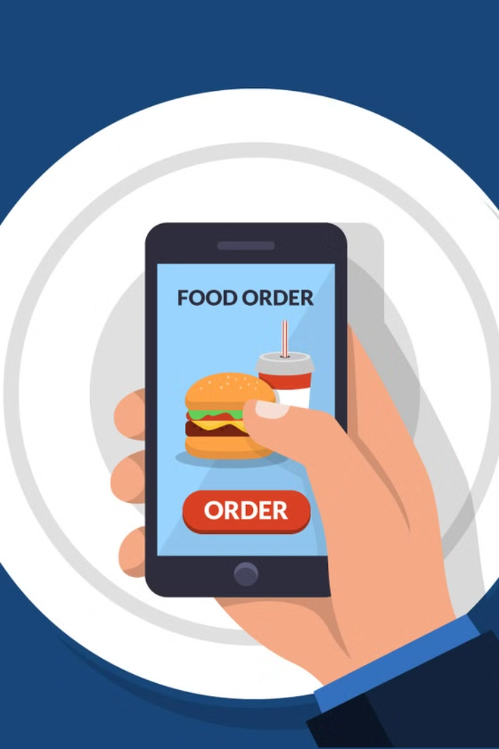



Customer Experience
Flexible
Browse Menu
Place Orders
Login
Customers can browse the menu, select food items, and add them to their cart.
Customers can place orders with ease and track their progress in real-time.
Customers can log in to place orders.

Slide 7

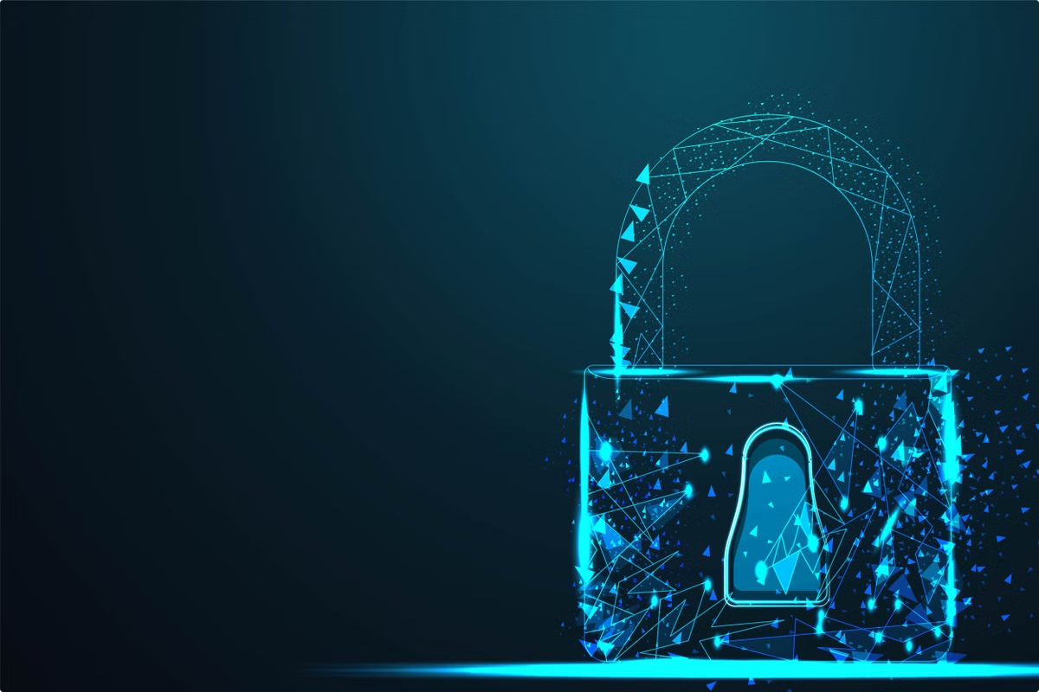
Secure Access
1
Authentication
The system uses secure authentication methods to verify admin identity.
2
Access Control
Unauthorized access is prevented through strict security measures.

Slide 8




Dynamic Menu Management
Item Updates
New Dishes
Menu Accuracy
Admins can update food items dynamically to reflect changes in availability or pricing.
New dishes can be added to the menu to expand customer options.
The system ensures that customers have access to an updated and accurate menu.

Slide 9

Simplified Ordering
Smooth Experience
Order Processing
Order Placement
The system is designed for a smooth user experience, minimizing complications.
The system efficiently processes multiple orders, ensuring timely handling.
Customers can easily place orders through the user-friendly interface.

Slide 10






Secure Payments
Payment Methods
Payments can in two ways: one is money another card payment
Transaction Security
The system integrates with secure payment systems for a safe and convenient checkout process.
System Trust
Secure payment integration enhances the overall reliability and trustworthiness of the system.

Slide 11

Conclusion
It streamlines the ordering process for customers
and administrators.
It improves efficiency, reduces human errors, and enhances the overall user experience.
Future enhancements is to optimize operations and customer satisfaction.

